Slide 1

Train Energy Prediction
By Muhammad Ahmad Mustafa
This presentation explores the prediction of train energy consumption.
We will cover the methodology, model, and findings.

Slide 2
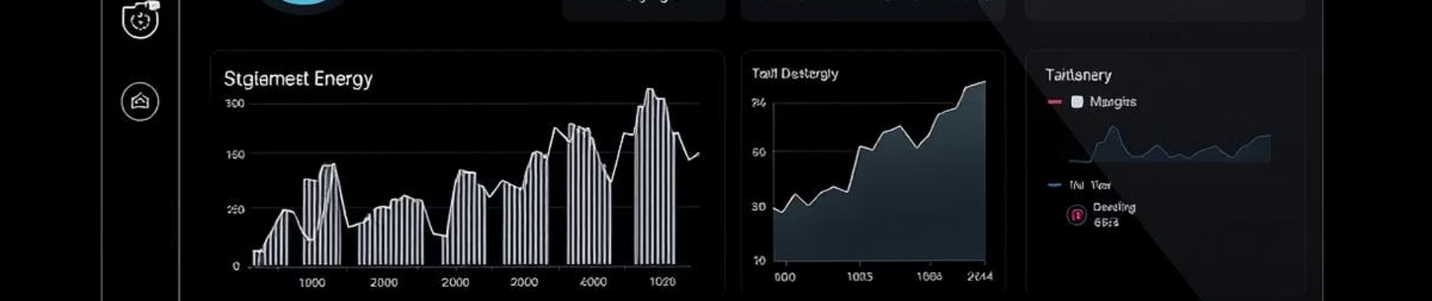
Project Introduction
Project Goal
Key Factors
Objective
Predict train energy consumption.
Square footage, occupants, appliances, weather.
Use machine learning for efficient energy decisions.

Slide 3
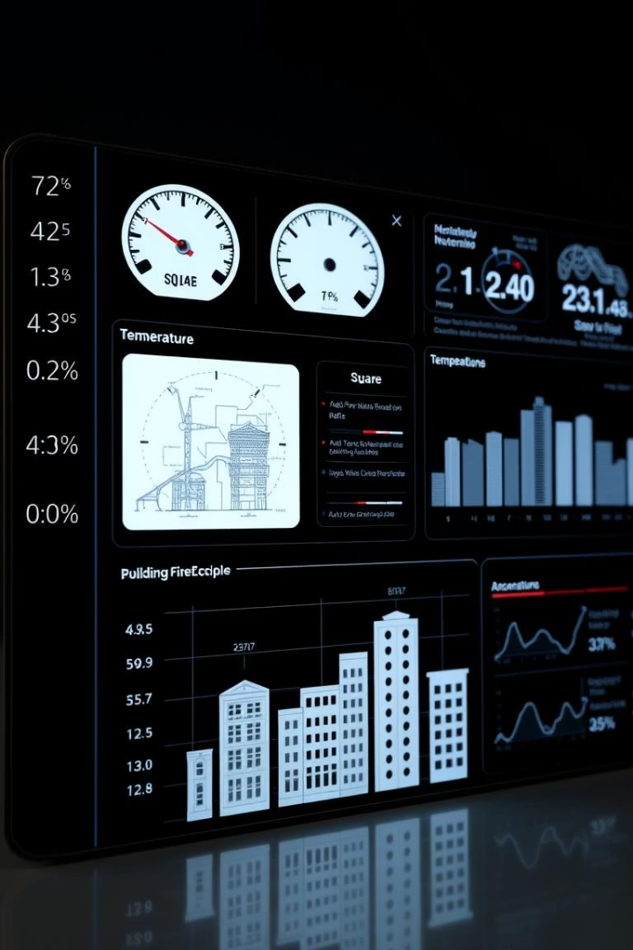
Dataset Overview
Square Footage
Number of Occupants
Appliances Used
Average Temperature
Building Type
Day of Week
Energy Consumption
Total area of the monitored space.
Count of individuals within the space.
Types and number of active appliances.
Ambient weather temperature.
Classification of the structure or environment.
Weekday or weekend indication.
Target variable for prediction.

Slide 4

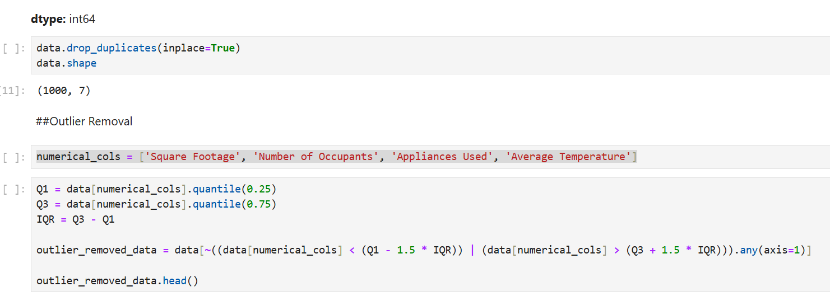




Preprocessing Steps
Clean Data
Handle Missing Values
Remove Outliers
Encode Categorical Data
Scale Numerical Features

Slide 5
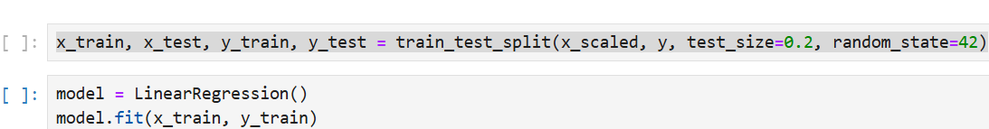
Modeling Approach
Data Split
Model Selection
80% for training, 20% for testing.
Linear Regression was applied.
Train on scaled features.
Simple and effective.
Evaluate on unseen data.
Learned feature relationships.

Slide 6
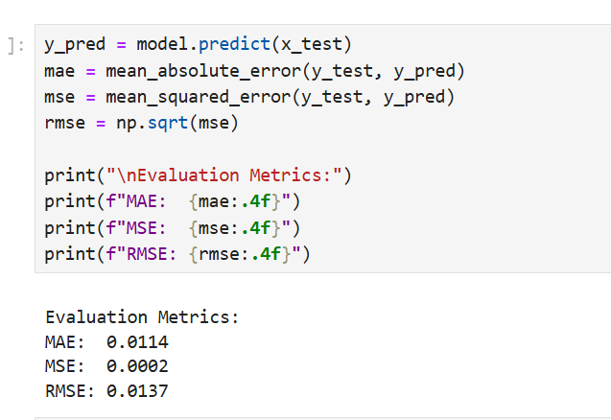
Evaluation Metrics
Mean Absolute Error (MAE)
Average absolute difference between predicted and actual values. It indicates average prediction error magnitude.
Mean Squared Error (MSE)
Average of squared differences between predictions and actual values. It penalizes larger errors more heavily.

Slide 7




Key Findings
Energy Factors
Square footage and appliances significantly impact energy.
Model Accuracy
Linear Regression provided reasonably accurate predictions.
Preprocessing Impact
Data preprocessing enhanced model performance.

Slide 8

Conclusion
This project successfully demonstrated the process of predicting train energy consumption using machine learning techniques. By carefully preprocessing the dataset—removing outliers, encoding categorical variables, and scaling features—we were able to train a linear regression model that showed reliable prediction performance. The results highlighted that features like square footage and appliance usage play a significant role in energy consumption. With more advanced models and additional data, the accuracy of predictions can be further improved, leading to better energy efficiency planning in railway operations.

